Slide 1

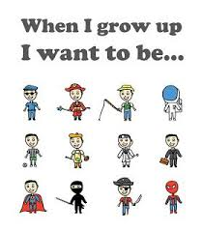
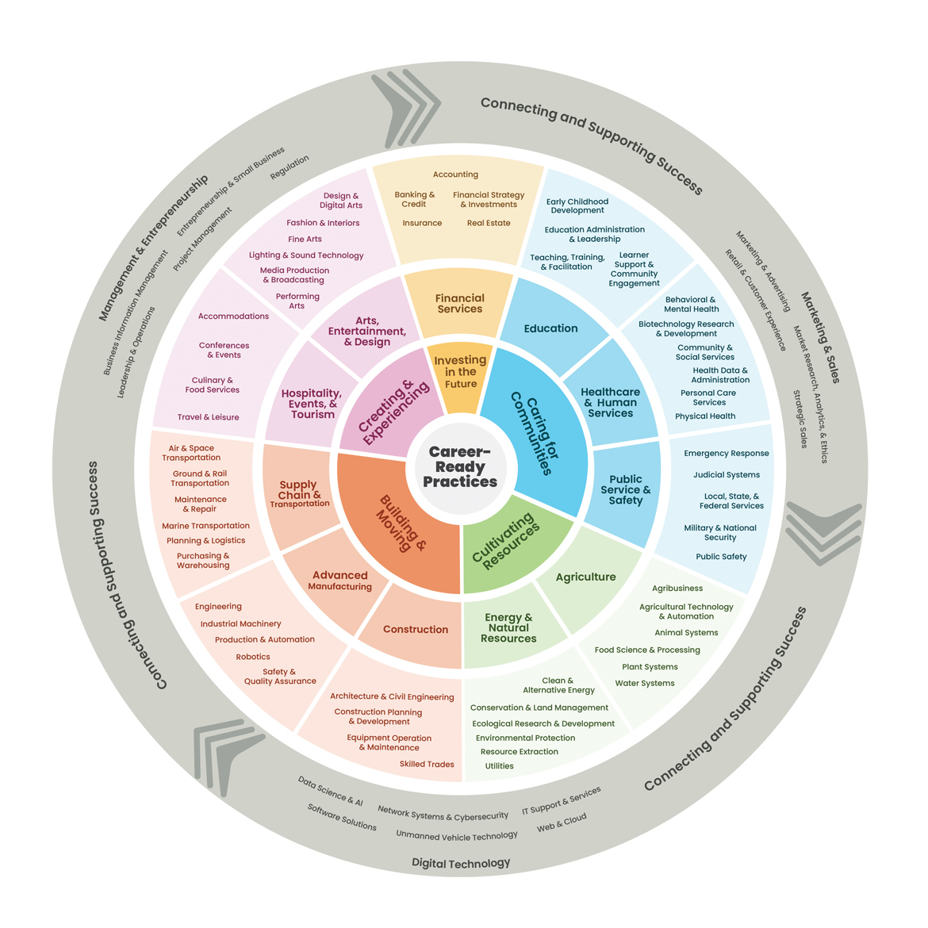

When you were little what is the first thing you remember wanting to be when you grew up?
Write it down on your paper.
Have you changed your mind since then?

Slide 2
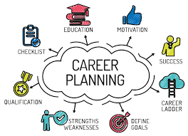
Do you have any future career plans yet?
Let’s look at some career areas to see if anything sparks your interest.

Slide 3
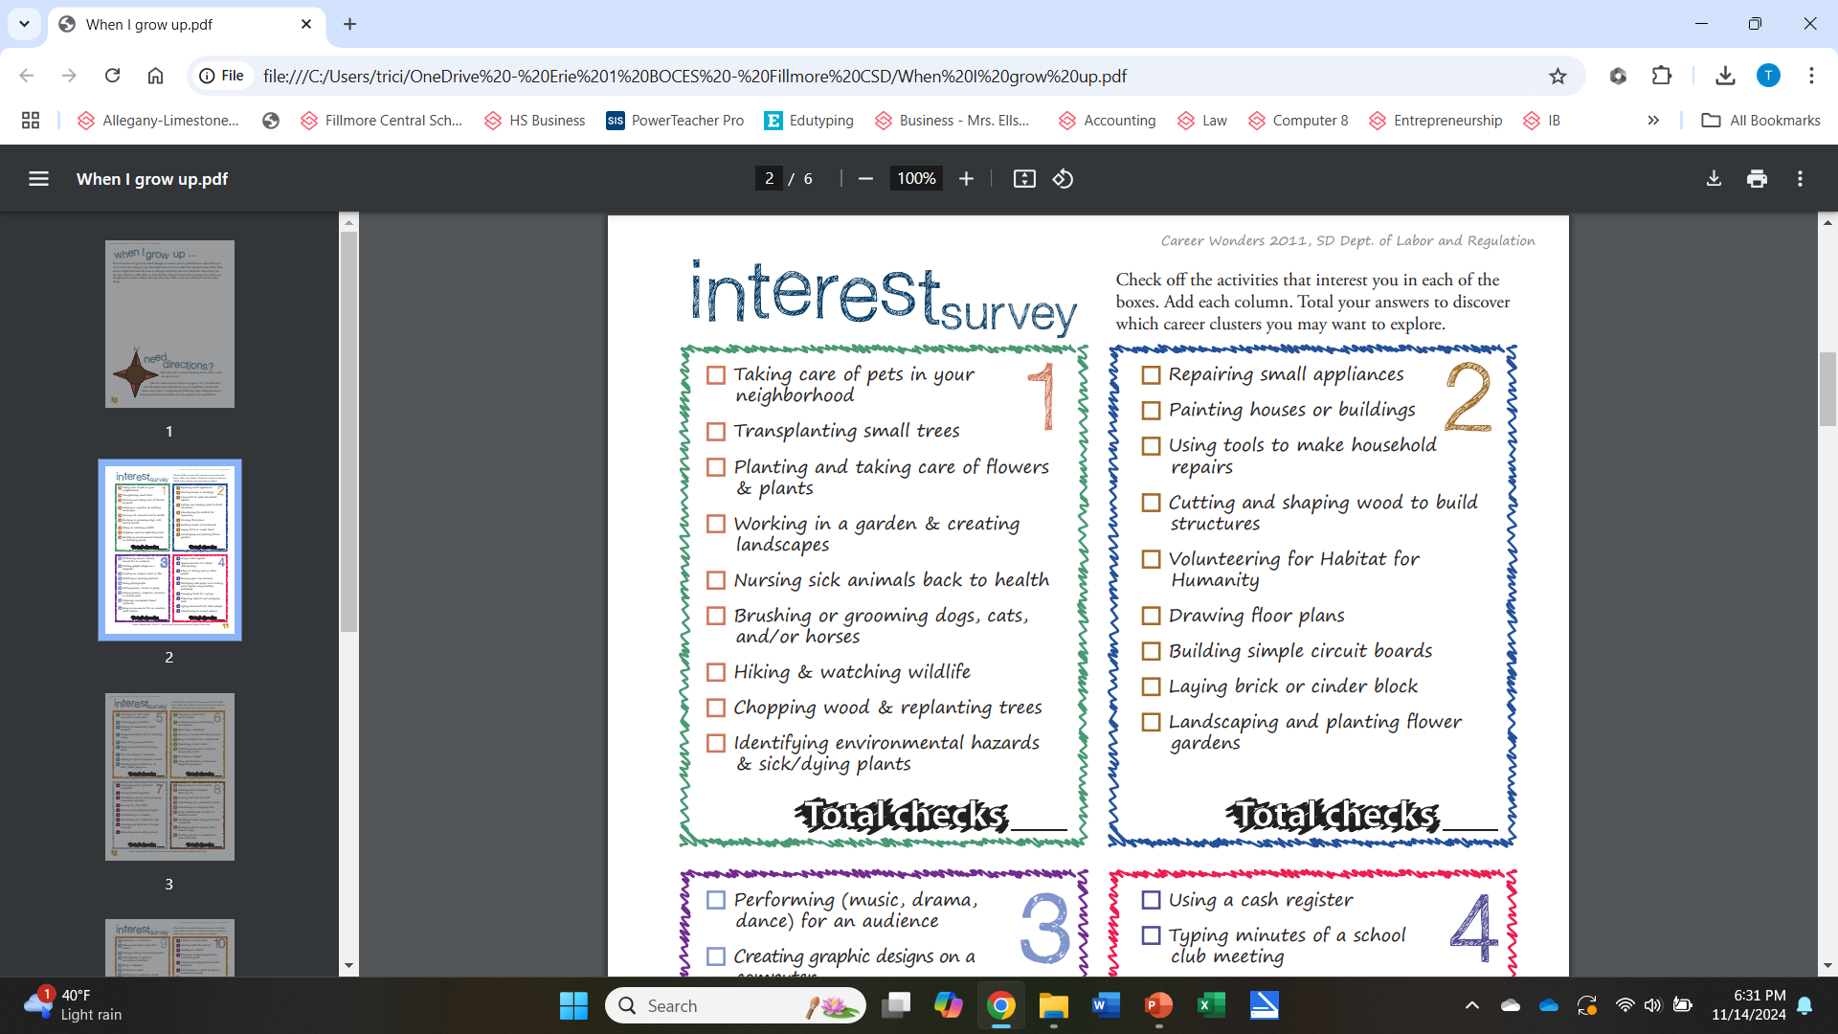

Slide 4
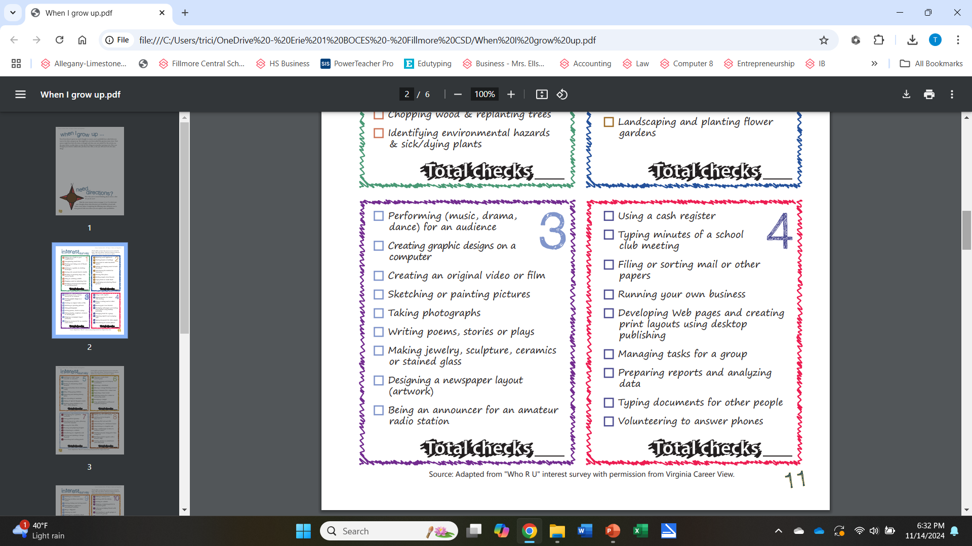

Slide 5
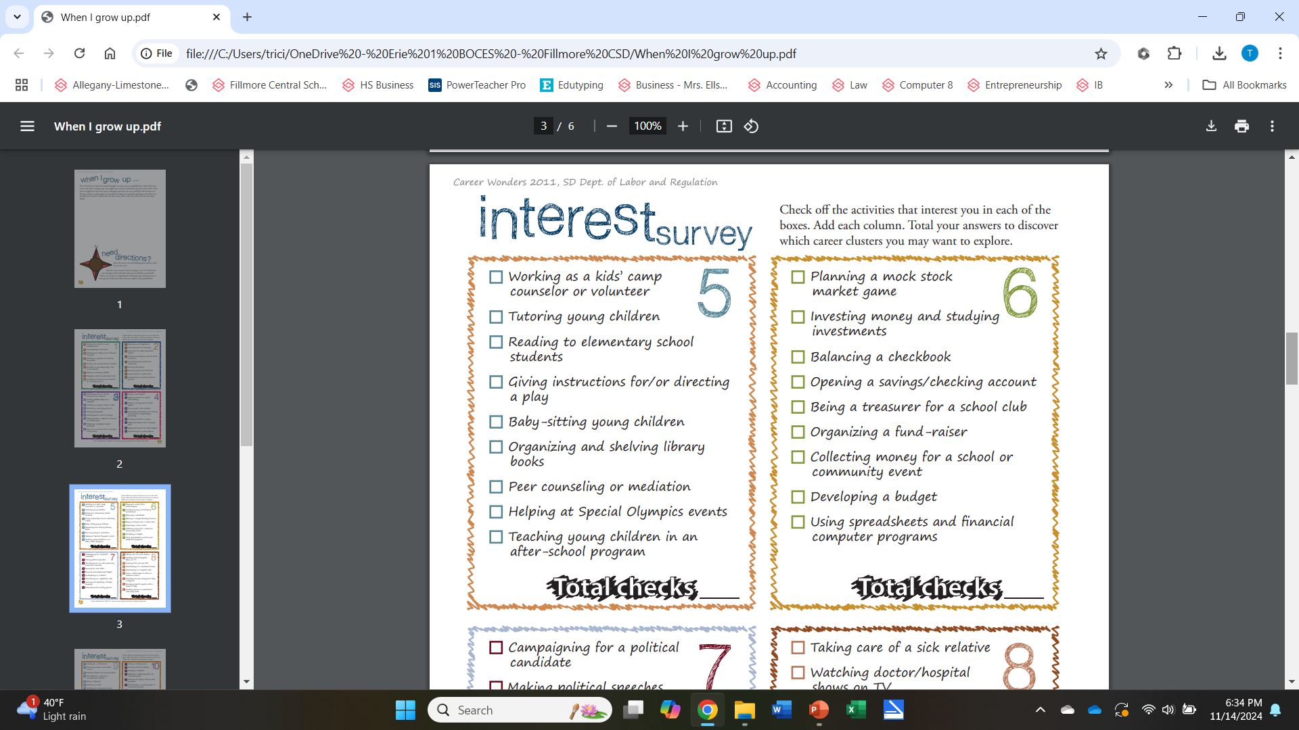

Slide 6
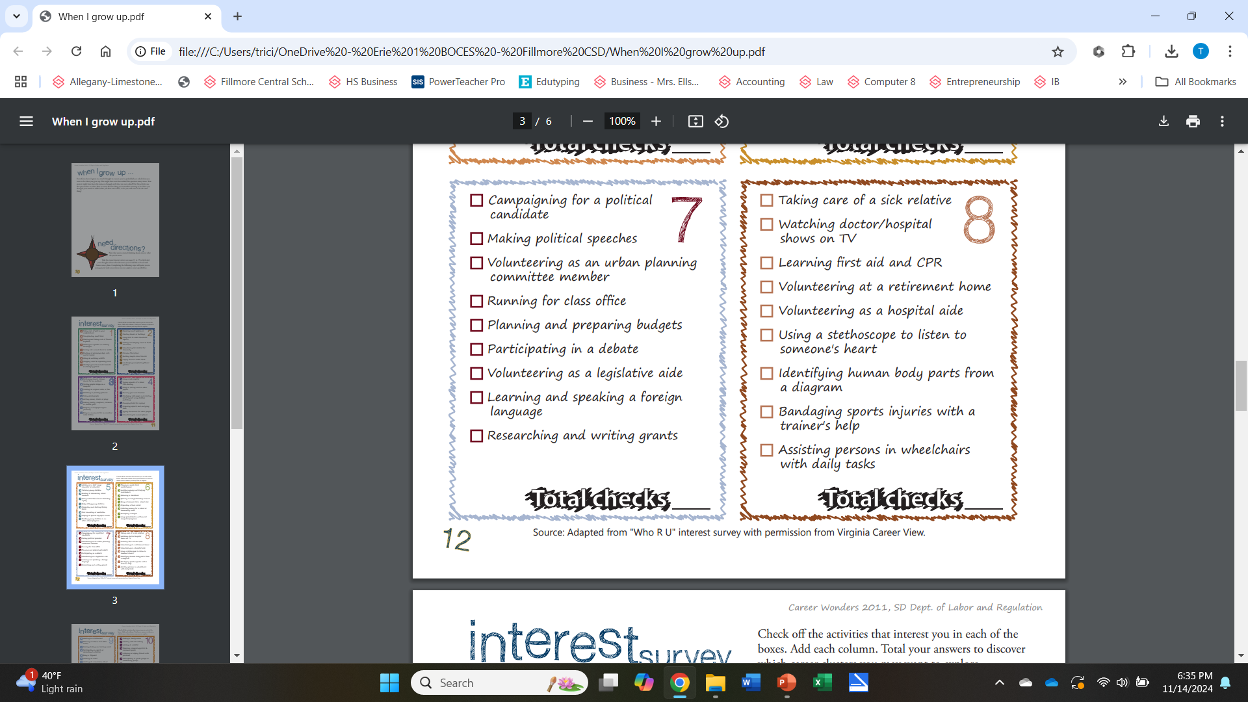

Slide 7
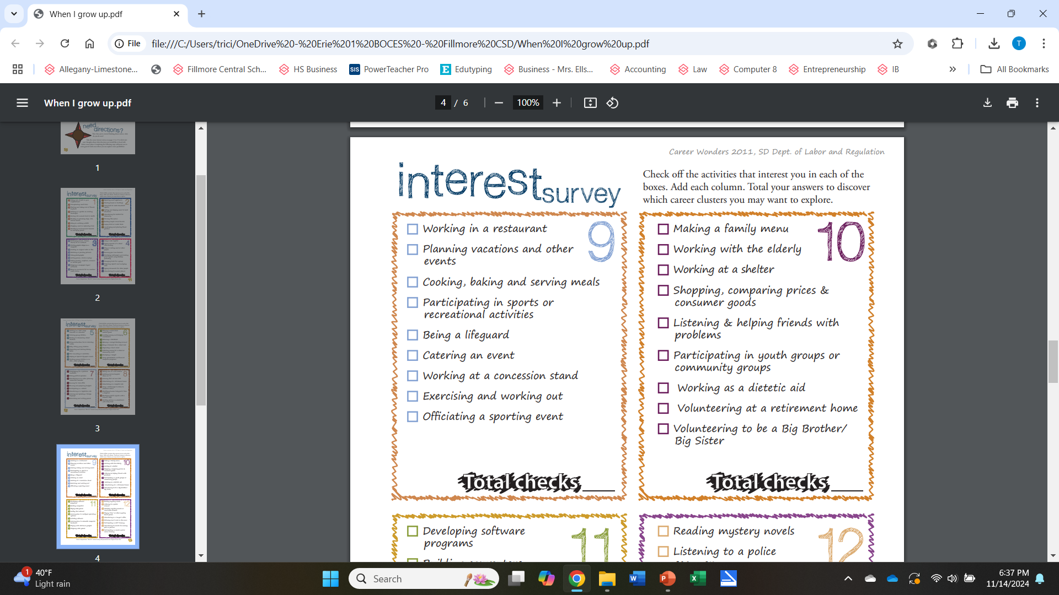

Slide 8


Slide 9
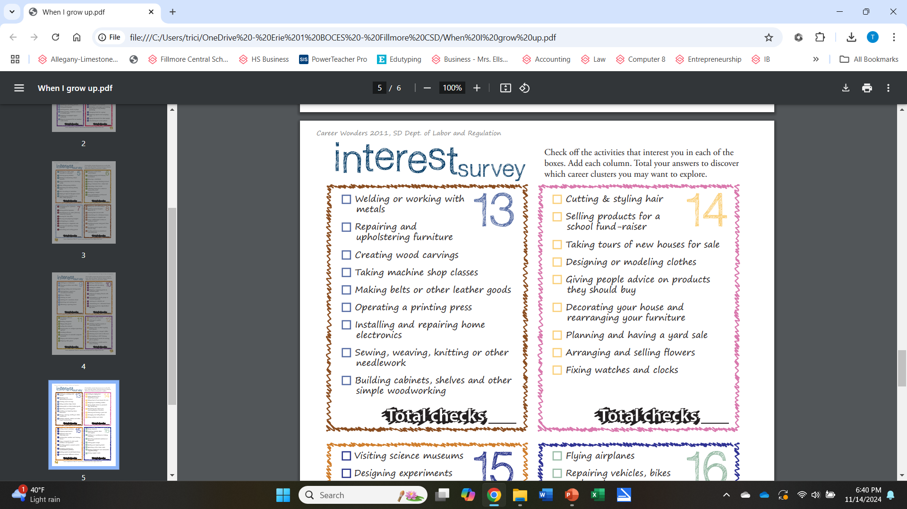

Slide 10
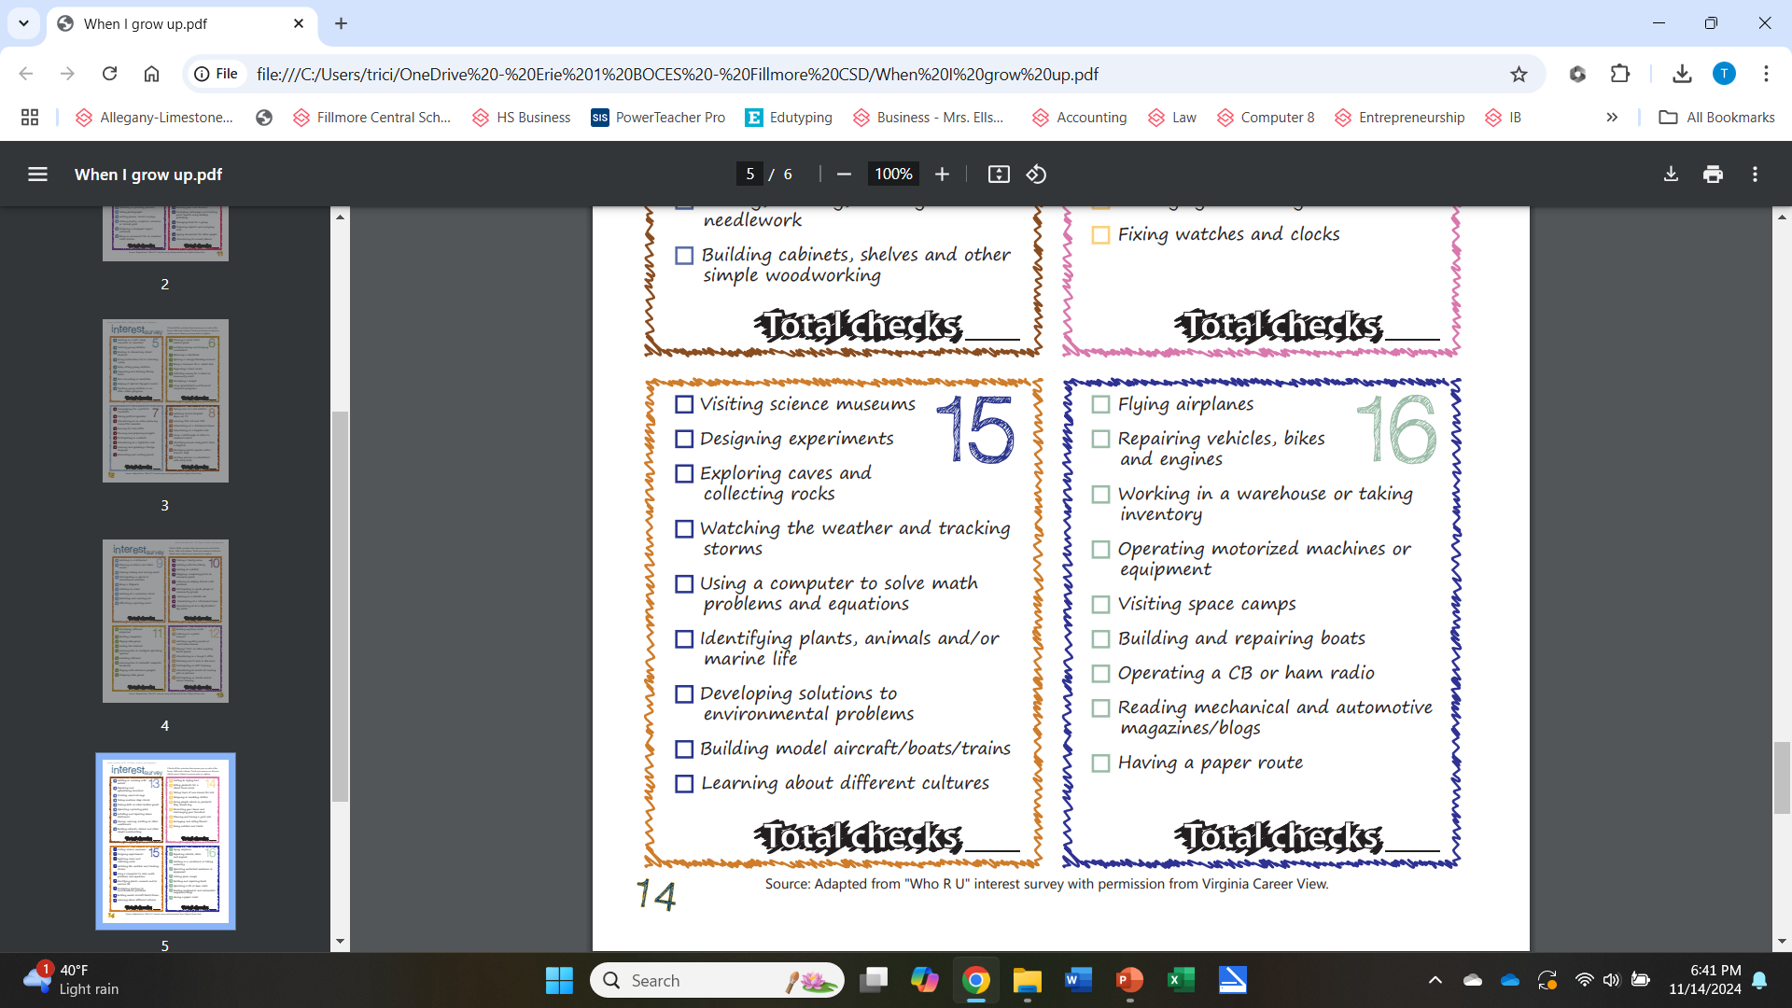

Slide 11
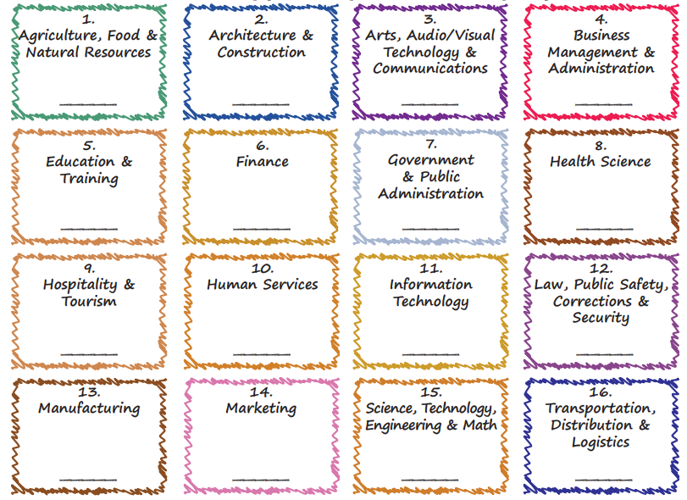
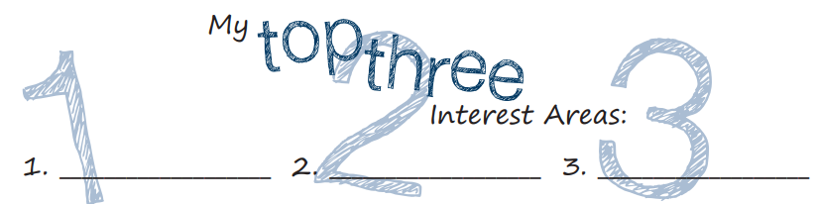

Slide 12

This interest survey was divided into 16 groups.
  Each group is called a Career Cluster.
Career Clusters place similar occupations in groups.
Some careers are placed in more than one cluster.
They allow you to connect what you learn in school
  to the skills and knowledge you need after school.

Slide 13
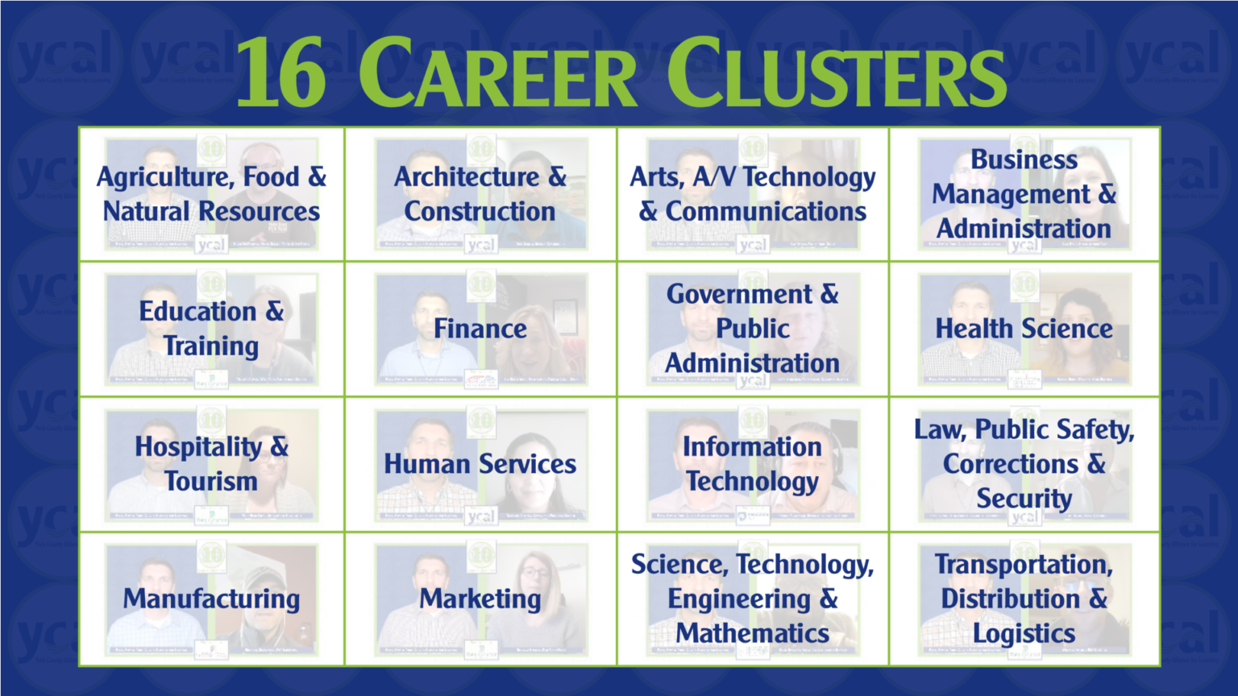
Your Future

Slide 14
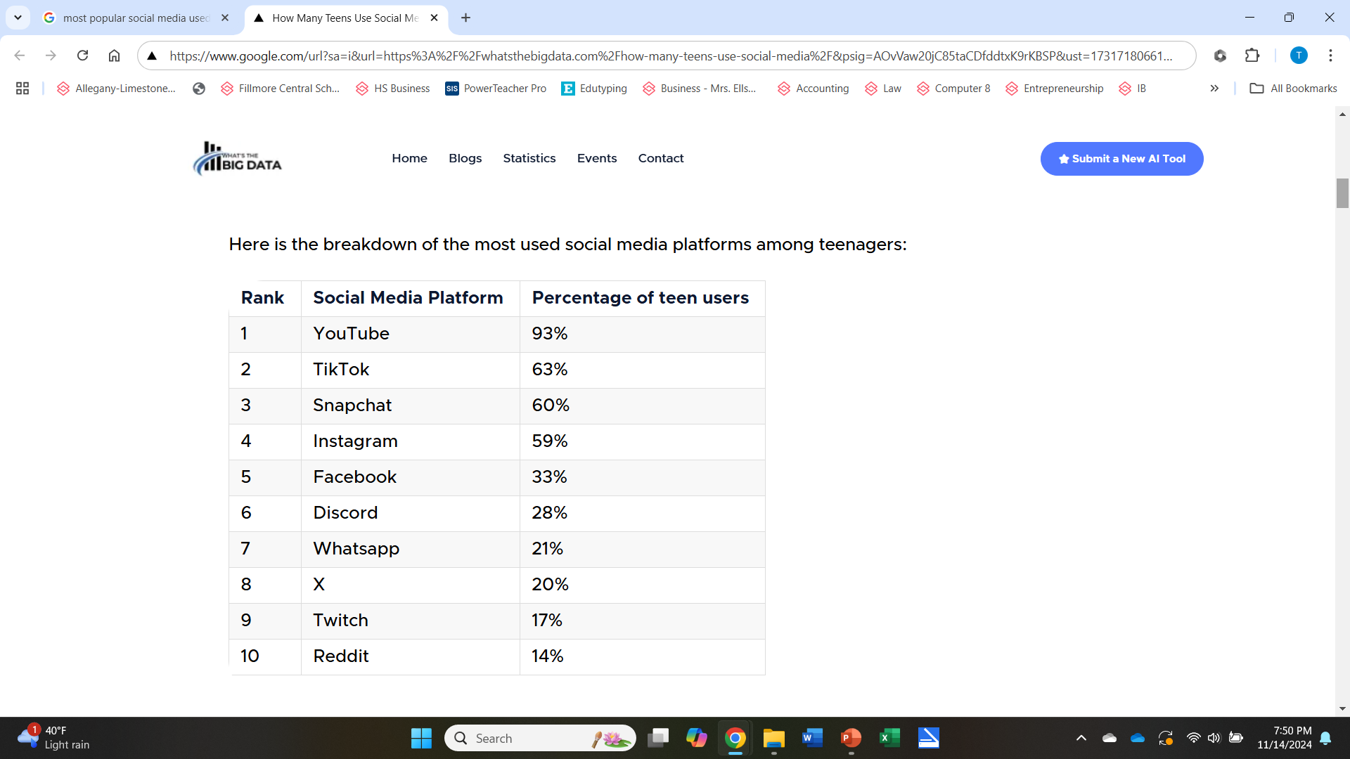

Social Media in your lives Today
https://whatsthebigdata.com/how-many-teens-use-social-media/

Slide 15
Do you know that things you share on social media today can affect your future negatively tomorrow?
What does TMI stands for?
Too Much Information
Have you ever seen someone post something online that you consider to be TMI?
What do YOU share on Social Media?

Slide 16
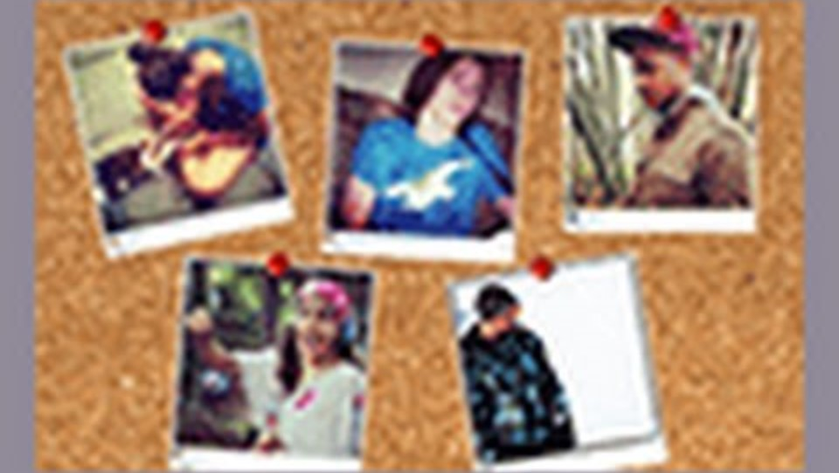

Slide 17
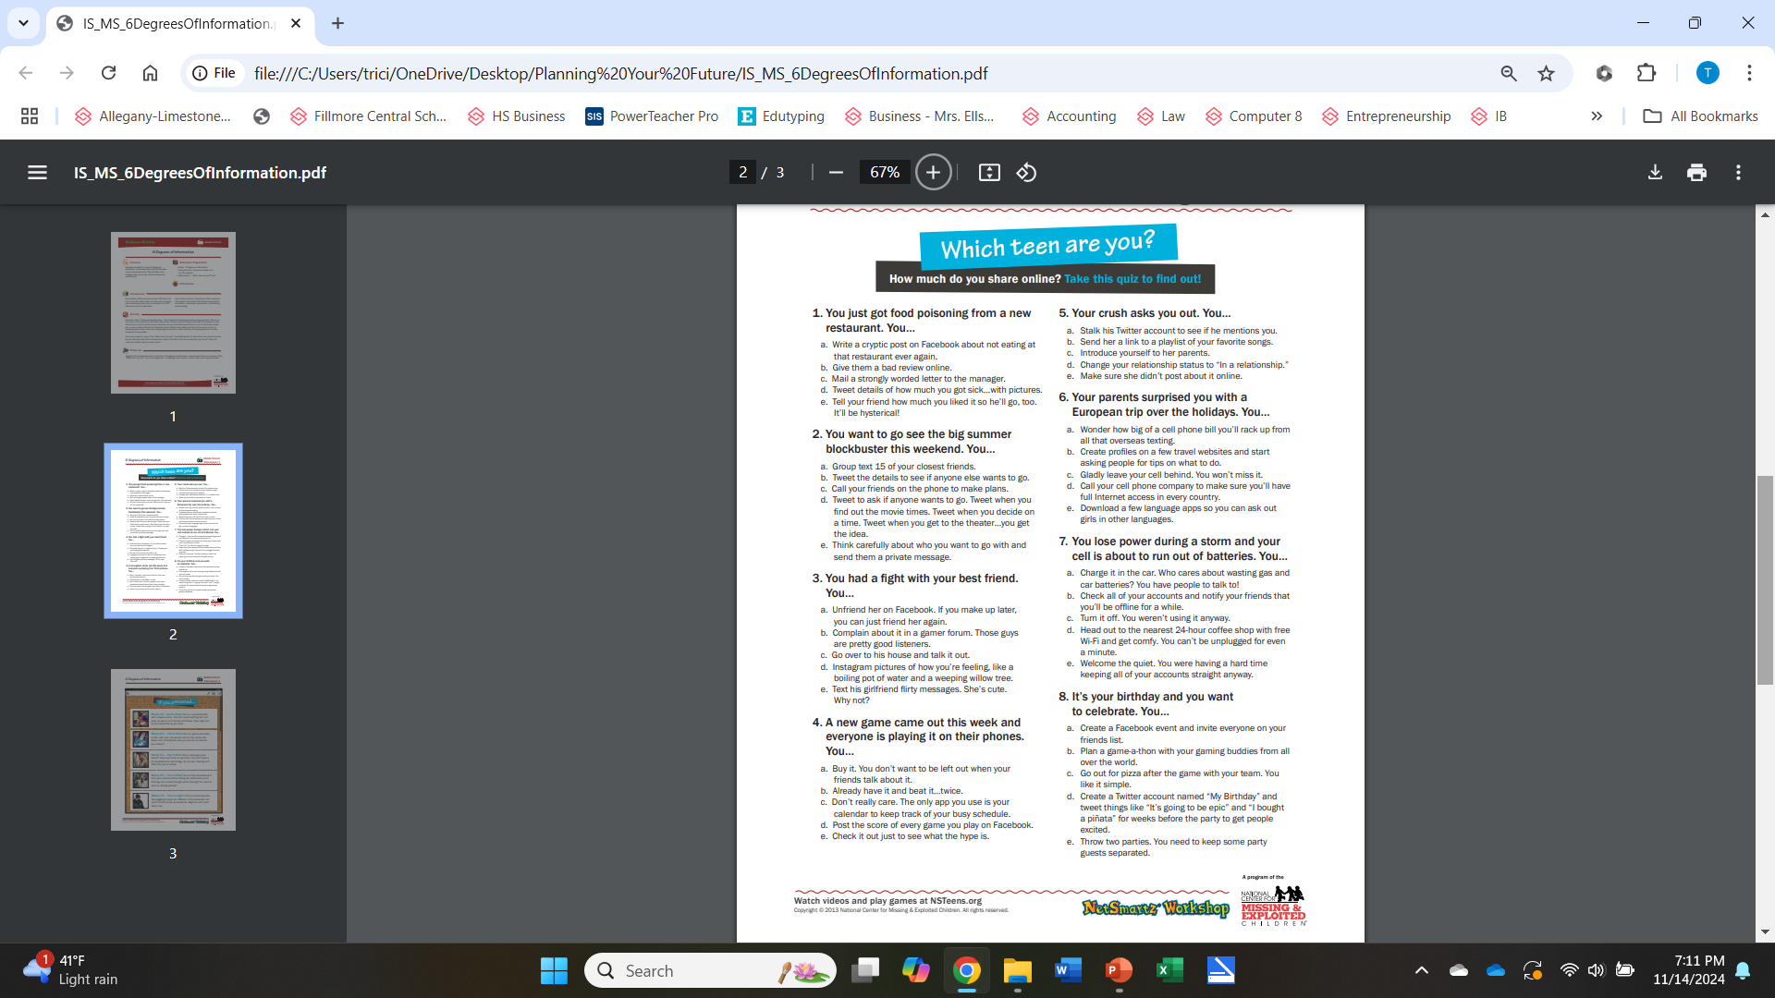

Slide 26
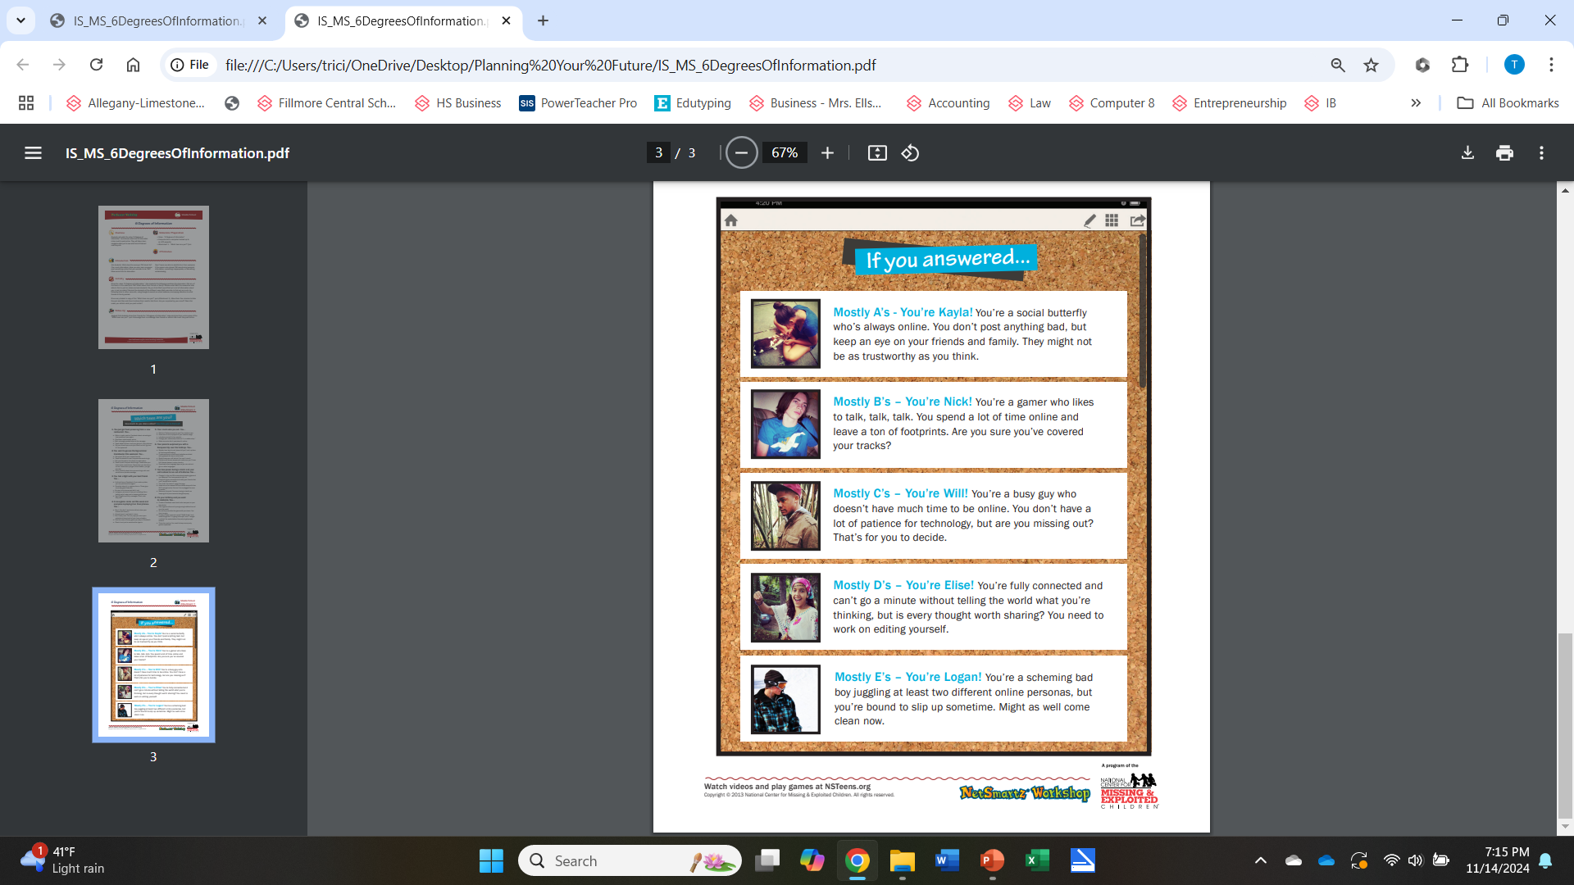

Slide 32


Slide 33
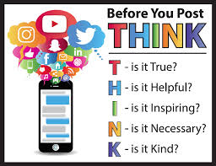

Slide 34
Resources
Source: Adapted from "Who R U" interest survey with permission from Virginia Career View.
Career Wonders 2011, SD Dept. of Labor and Regulation.
https://whatsthebigdata.com/how-many-teens-use-social-media/
https://careertech.org/career-clusters/
https://ycal.us/students/10careerquestions/
https://www.missingkids.org/netsmartz/home

